Slide 1
Shapes Pew Peww
Matthew Gattis
John Boling
Randall Harper

Slide 2
Major Features
Single player survival mode
Health pool
Ammo pool
Enemies
Bosses
Multiple weapons
Item store
Death

Slide 3
Functional Requirements
R1:SPP shall have a single player survival mode
R1.1:SPP Shall have endless waves of enemies until the player dies.
R2:SPP shall remove health from the player’s health pool when they are hit by an enemy.
R2.1:SPP shall have characters die when their health reaches zero.
R2.2:SPP shall have the game end when the player dies.
R3:SPP shall have ammo held by the player in their inventory.
R4:SPP shall have an ammo “drop point” located on the map.
R5:SPP shall have enemies spawn in increasing number as a player progresses further in survival mode.

Slide 4
Functional Requirements cont.
R6:SPP shall have enemies drop money for the player when killed.
R7:SPP shall spawn stronger enemies, “Bosses”, every 10 waves.
R7.1:SPP shall have Bosses, when killed, drop a larger loot amount than normal enemies.
R8:SPP shall have an item store that will be accessible at any time.
R8.1:SPP shall have the store contain purchasable item upgrades.

Slide 5
Nonfunctional Requirements
The game shall be graphically simple.
The game system shall be available 99.98% of the time.
The interface shall contain buttons that are easily accessible.
The interface shall inform the user about current life, ammo, and total store credits.

Slide 6
Feasibility Study
Development Platform and system requirements
Platform: Windows XP or higher
Use, at minimum, Visual Studio 10.0.40219.1. Both 32-bit and 64-bit libraries will be included
If you’re not using Visual Studio, simply run the .exe file

Slide 7
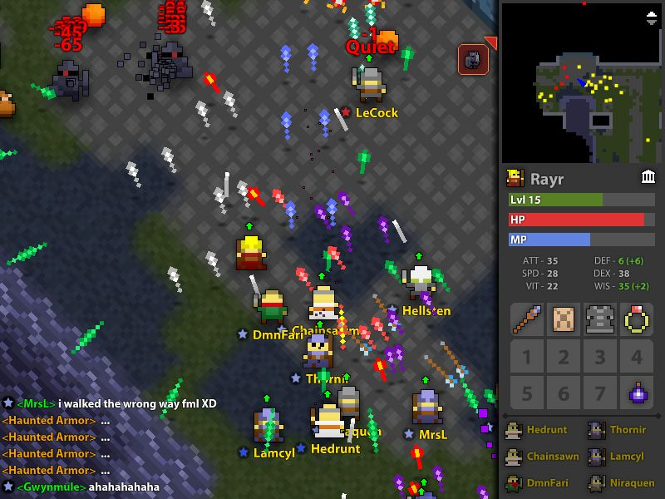
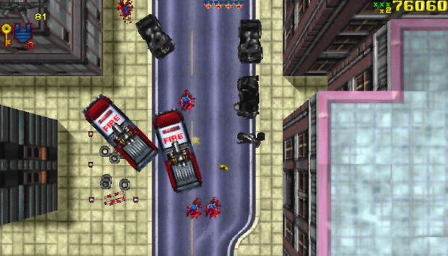
Feasibility Study – Comparison
Realm of the Mad God
Advantages: online multiplayer, open world
Disadvantages: very clustered
Grand Theft Auto 1 and 2
Advantages: Unique story line
Disadvantages: difficult to control

Slide 8
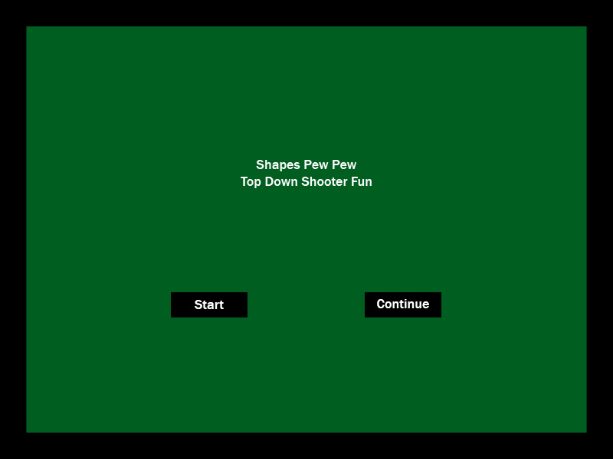
User Interface Mockup

Slide 9
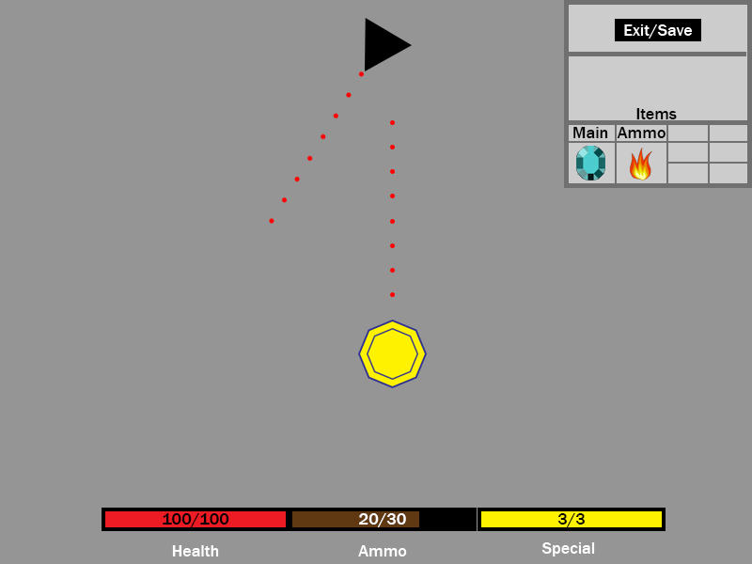
UI Mockup – Game Screen

Slide 10
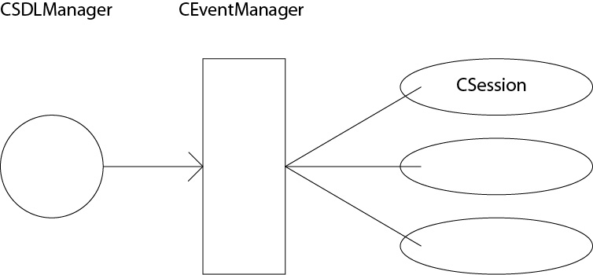
Architectural Model – Event-Driven

Slide 11
Domain Modeling

Slide 12
Team Member Assignments
Team Member | First Iteration | Second Iteration | Third Iteration
Matthew Gattis | Event Manager Environment setup UML | Graphic Implementation | Score/Save game Improvements
John Boling | UI Mockup Planning PowerPoint | Graphics Design and Interface | Character Levels
Randall Harper | PowerPoint Architectural model | Bosses/Enemy Control | Weapons/Ammo

Slide 13
Appendix
We built this project for PC users, sorry if you have a Mac.
Go to https://github.com/Jboling/TestProject7
Download the .zip of all the project files
For more a more detailed installation guide, find the Installation ReadMe PowerPoint on https://github.com/Jboling/TestProject7

